Slide 1
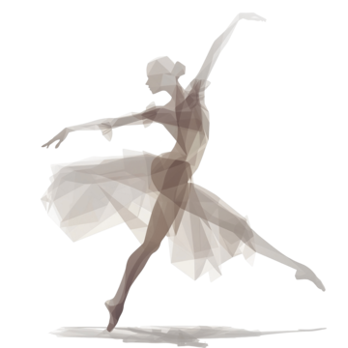
A BREAKTHROUGH FROM BALLET

Slide 2
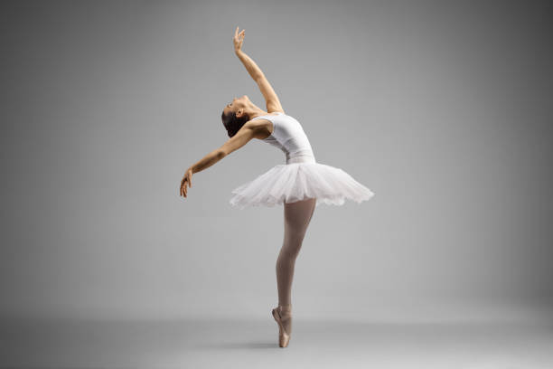
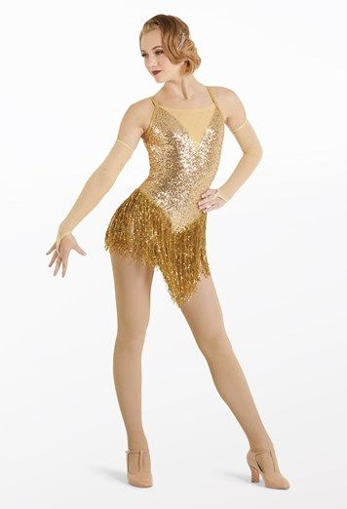
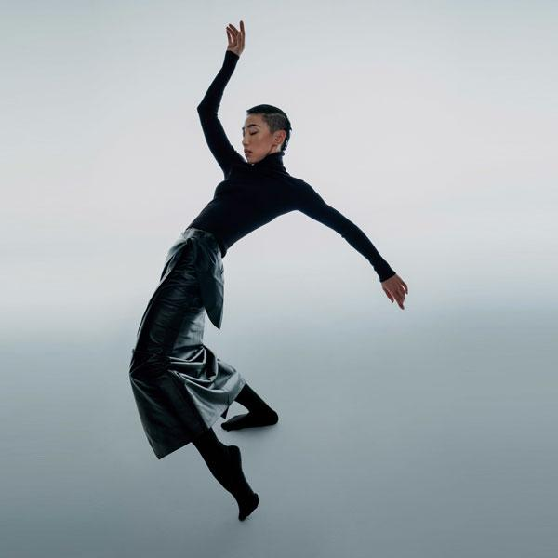
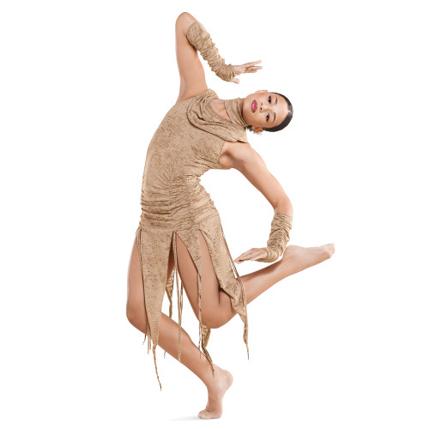
15TH AND 16TH CENTURIES
TIMELINE
19TH AND 20TH CENTURIES
JAZZ DANCE
CONTEMPORARY
DANCE
BALLET
18TH AND 19TH CENTURIES
MODERN DANCE
MID-20TH CENTURIES

Slide 3
JAZZ DANCE

Slide 4
The origins of jazz dance are found in the rhythms and movements brought to America by African slaves. A dance to jazz accompaniments, composed of a profusion of forms.
Jazz dance paralleled the birth and spread of jazz itself from roots in Black American society bringing it to Europe and was popularized in ballrooms by the big bands of the swing era.
It incorporates ragtime moves, Charleston, Lindy hop, Cakewalk, Jitterbug and mambo. Notable jazz dancers are: Katherine Dunham, Jack Cole, Bob Fosse, Gene Kelly, Luigi Faccuito

Slide 5
THE CHARACTERISTICS OF JAZZ DANCE
The use of bent knees, excluding those times when the dancer is jumping.
The use of the whole foot, in that the weight can be immediately shifted from one foot to the other.
The isolation of body parts in movement, such as only the head, shoulders, rib cage, and hips.
Individualism of style within a group style.
Functionalism, becoming what you dance, the art of real life.

Slide 6
SUBGENRES OF JAZZ DANCE
CLASSICAL JAZZ- Ballet and Modern Dance heavily influence the classical Jazz Dance technique. This is one of the most exquisite types of Jazz Dance.
BROADWAY JAZZ- Dynamic, theatrical dance style blending traditional jazz technique with storytelling, character development, and dramatic choreography. It features intricate footwork, expressive gestures, and dynamic staging, embodying characters and narratives from musical theater through movement.
AFRO-JAZZ- A modern form of dance, with its original and traditional African-American ethnic roots.
LATIN JAZZ- Combined with the elements of Samba and Salsa, this type of Jazz Dance is usually performed under Latin American Rhythms.

Slide 7
SUBGENRES OF JAZZ DANCE
CONTEMPORARY JAZZ- This is the most common style of Jazz Dance that is prevalent today. Contemporary Jazz Dance shares the movement characteristics with the contemporary modern Dance. The main focus of these dancers is on expressing their emotions through expressions, extensions, and turns.
JAZZ FUNK- Jazz Funk is closer to Hip Hop while Jazz draws more technical influences from Ballet & Modern dance.
COMMERCIAL JAZZ- This is the type of Jazz Form which is used for commercial purposes. It is more of an entertainment-driven Jazz, meant to sell or promote a product or a service. This type of Jazz Dance form is more used in music videos, movies, televisions, and profit-performances.

Slide 8
MODERN DANCE

Slide 9
Modern dance primarily arose out of Europe and the United States in the late 19th and early 20th centuries. It was considered to have been developed as a rejection of, or rebellion against, classical ballet, and also a way to express social concerns like socioeconomic and cultural factors.
In the late 1800s and early 1900s, dancers Isadora Duncan and Loie Fuller popularized the dance form as a new style of artistry and entertainment with their lyrical, emotional performances.

Slide 10
Isadora Duncan- Duncan technique is free-flowing and appears spontaneous; has a sense of energy, grace, and is a state of mind as much as a style of movement.
MODERN DANCE PIONEERS AND
THEIR CONTRIBUTION
Lester Horton- Horton Technique emphasizes a whole body, anatomical approach to dance that includes flexibility, strength, coordination and body and spatial awareness to enable unrestricted, dramatic freedom of expression.
Humphrey-Weidman- The fall and recovery technique.

Slide 11
Rudolf von Laban- Laban Movement/Effort- Develop dance notation and movement analysis (space, time, weight, flow)
Merce Cunningham- Cunningham technique a rigorous training method for dance that emphasizes the use of space and time in movement.utilize their torsos, bending sideways, forward and backward, and hold balances for long periods.
Martha Graham- Graham technique fundamental principles of the technique include contraction and release, the shift of weight, and spirals that create dramatic tension.
José Limón- Limón technique emphasizes the use of weight, gravity, and breath to create expressive movements

Slide 12
CONTEMPORARY DANCE

Slide 13
Contemporary dance is a style of interpretive dance that embraces innovation, blending techniques from various genres, including classical ballet, jazz, modern dance, and lyrical dance. It relies on improvisation and versatility and is characterized by freedom of movement and fluidity, letting dancers explore the mind-body connection and ideally evoking emotion in the audience. Contemporary dance is sometimes considered a form of storytelling, and dancers may use the medium to portray characters, replay events, or convey personal stories. Its routines may also communicate abstract ideas, such as ethical values, acceptance of self, and timely social issues.

Slide 14
Improvisation: Contemporary dance is based on improvisation, creativity, and versatility. Floor work: Contemporary dance focuses more on floor work than leg work and pointe. Communication: Contemporary dance can be used to communicate abstract ideas, such as social issues, or to tell a story. Musical styles: Contemporary dance can be performed to a variety of musical styles, spoken word poems, or songs, or even in silence
Characteristics of Contemporary Dance

